Slide 1


Slide 2
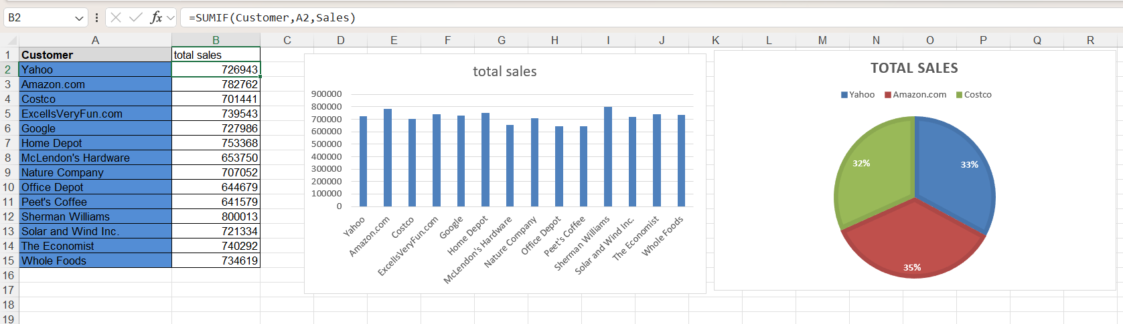
I used the SUMIF function to calculate the total sales for each customer

Slide 3
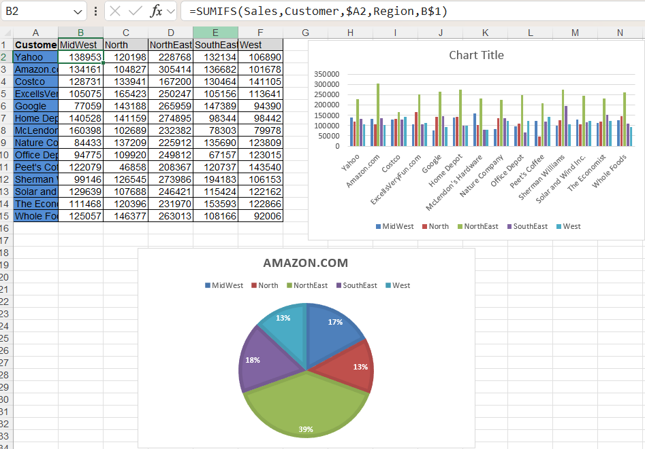
The total sales for each customer were calculated by region using the SUMIFS function

Slide 4
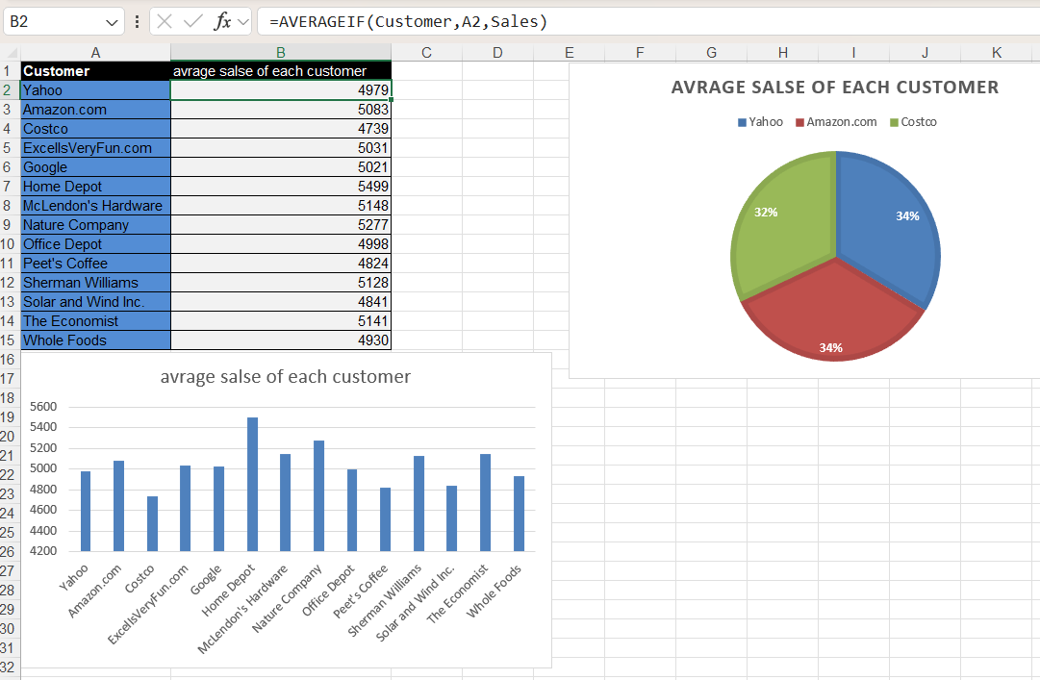
I used the AVERAGEIF function to calculate the average sales for each individual customer.

Slide 5
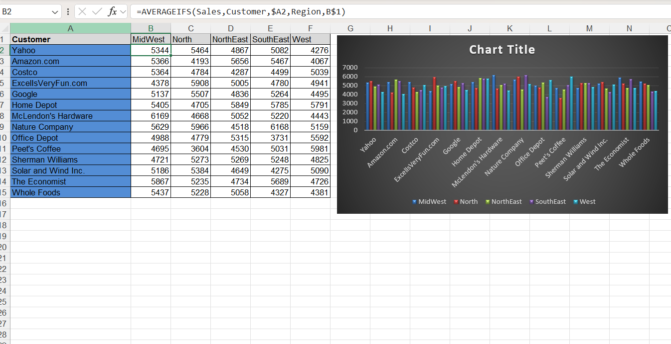
I used a averageifs to calculate the average sales for each customer within each region

Slide 6
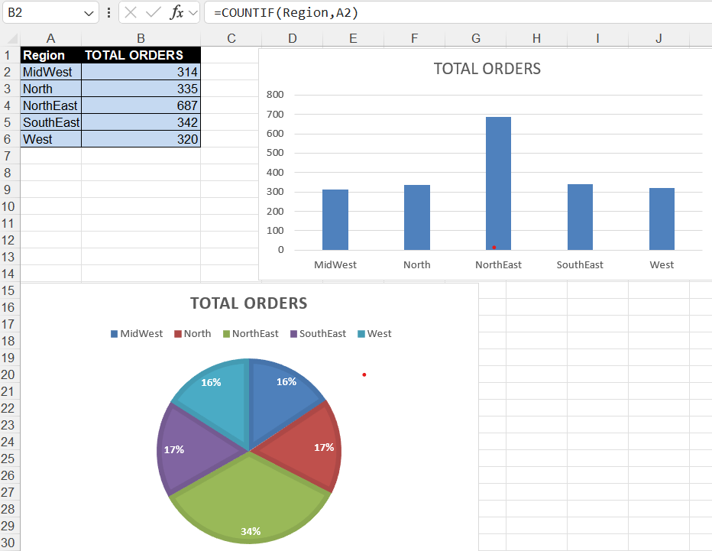
I used a countif to count the total number of orders for each region

Slide 7
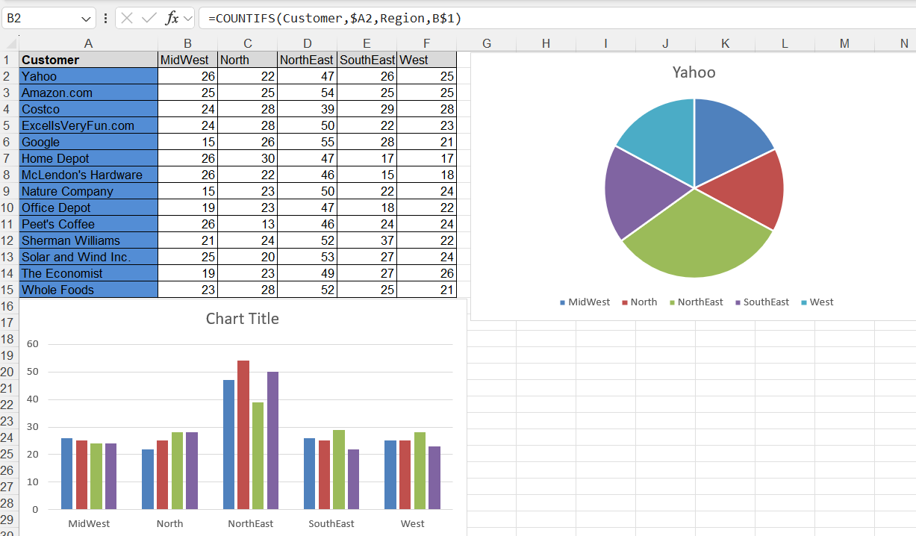
I used a countifs to count the total number of orders for each region

Slide 8
